Slide 1
Comparing more than two means
NRES 776
Instructor: Heather Bryan
Oct 7, 2021

Slide 2
Learning Objectives
Describe components of variation in a one-way ANOVA
Conduct and interpret a one-way ANOVA
Conduct posteriori tests of pair-wise differences
Conduct and interpret a Kruskal-Wallis test

Slide 3
The analysis of variance
Which of the following best describes the concept of an ANOVA analysis?
We compare the differences between group means to see if they are less than expected from the variation within the groups.
We compare the differences between group means to see if they are more than expected from the variation within the groups.
We compare the values of the group means to see if they are less than expected from the values within the groups.
We compare the values of the group means to see if they are more than expected from the values within the groups.

Slide 4
The analysis of variance
Which of the following best describes the concept of an ANOVA analysis?
We compare the differences between group means to see if they are less than expected from the variation within the groups.
We compare the differences between group means to see if they are more than expected from the variation within the groups.
We compare the values of the group means to see if they are less than expected from the values within the groups.
We compare the values of the group means to see if they are more than expected from the values within the groups.
The correct answer is B.

Slide 5
One-way ANOVA
Comparing >2 means

Slide 6
One-way ANOVA
Comparing >2 means
Are individuals from different groups, on average, more different than individuals chosen from the same group

Slide 7
One-way ANOVA
Comparing >2 means
Are individuals from different groups, on average, more different than individuals chosen from the same group
General approach is to partition the sum of squares (variation) between random error and treatment (group effect)
$${SS}_{total}={SS}_{among groups}+{SS}_{within groups}$$

Slide 8
One-way ANOVA
Comparing >2 means
Are individuals from different groups, on average, more different than individuals chosen from the same group
General approach is to partition the sum of squares (variation) between random error and treatment (group effect)
$${SS}_{total}={SS}_{among groups}+{SS}_{within groups}$$
If the SS_{among groups} is large compared to the SS_{within groups} we conclude there are significant treatment effects ...

Slide 9

One-way ANOVA
Example: Shifts in circadian rhythm

Slide 10
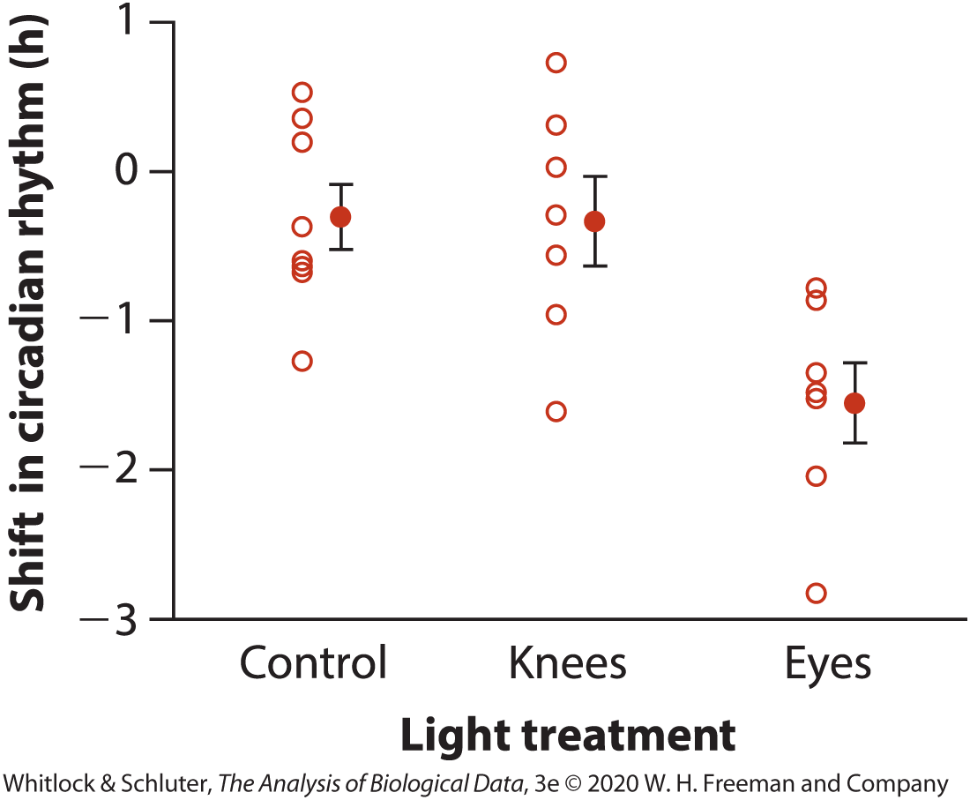
One-way ANOVA
Treatment | Data (h) | Ȳ | s | n
Control | 0.53, 0.36, 0.20, −0.37, −0.60, −0.64, −0.68, −1.27 | −0.3088 | 0.6176 | 8
Knees | 0.73, 0.31, 0.03, −0.29, −0.56, −0.96, −1.61 | −0.3357 | 0.7908 | 7
Eyes | −0.78, −0.86, −1.35, −1.48, −1.52, −2.04, −2.83 | −1.5514 | 0.7063 | 7

Slide 11
One-way ANOVA
H₀: All samples come from the same (statistical) population.
i.e. Among group variance = 0.
aka H₀: µ₁ = µ₂ = µ₃ = µ₄ … = µ_{k}
H_{A}: Not all populations have equal means (at least one is different from the others).
i.e. Among group variance > 0.

Slide 12
ANOVA Table for Circadian Rhythm Data
Source of variation | Sum of squares | df | Mean squares | F-ratio | P
Groups (treatment) | 7.224 | 2 | 3.6122 | 7.29 | 0.004
Error | 9.415 | 19 | 0.4955
Total | 16.639 | 21

Slide 13
One-way ANOVA: Partitioning the sum of squares
The total variation: the difference between each observation (Y_{i}) and the grand mean of the data

Slide 14
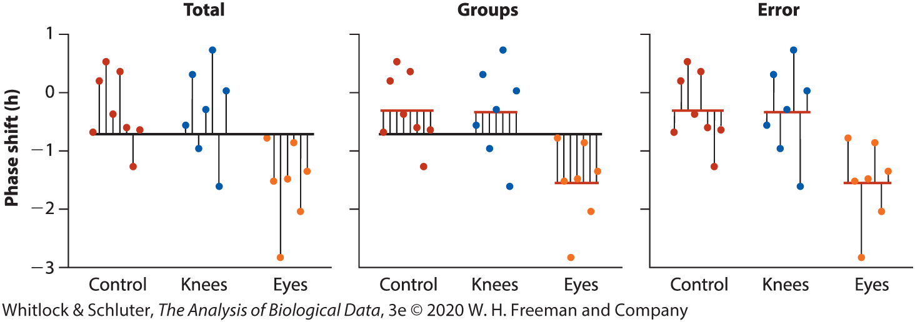
One-way ANOVA: Partitioning the sum of squares
The total variation: the difference between each observation (Y_{i}) and the grand mean of the data

Slide 15



One-way ANOVA: Partitioning the sum of squares
The total variation: the difference between each observation (Y_{i}) and the grand mean of the data
grand mean
$${SS}_{total}=\sum_{i=1}^{a}{\sum_{j=1}^{n}{{\left(y_{ij}−\overline{y}\right)}^{2}}}$$
observation $j$ in group $i$
$a$: treatments or groups (levels of a factor)
$n$: replicates of a treatment or group

Slide 16
One-way ANOVA: Partitioning the sum of squares
Variation among groups: Deviation between the mean of the group to which an observation belongs and the grand mean

Slide 17
One-way ANOVA: Partitioning the sum of squares
Variation among groups: Deviation between the mean of the group to which an observation belongs and the grand mean

Slide 18




One-way ANOVA: Partitioning the sum of squares
Variation among groups: Deviation between the mean of the group to which an observation belongs and the grand mean
grand mean
$${SS}_{among groups}=\sum_{i=1}^{a}{\sum_{j=1}^{n}{{\left({\overline{y}}_{i}−\overline{y}\right)}^{2}}}$$
mean of group $i$
$$=\sum_{j=1}^{a}{{n_{i}\left({\overline{y}}_{i}−\overline{y}\right)}^{2}}$$
$a$: treatments or groups (levels of a factor)
$n_{i}$: replicates of treatment or group $i$

Slide 19
One-way ANOVA: Partitioning the sum of squares
Variation within groups: Deviation between each observation and the group mean (also called SS_{error})

Slide 20
One-way ANOVA: Partitioning the sum of squares
Variation within groups: Deviation between each observation and the group mean (also called SS_{error})

Slide 21




One-way ANOVA: Partitioning the sum of squares
Variation within groups: Deviation between each observation and the group mean (also called SS_{error})
mean of group $i$
$${SS}_{within groups}=\sum_{i=1}^{a}{\sum_{j=1}^{n}{{\left(y_{ij}−{\overline{y}}_{i}\right)}^{2}}}$$
observation $j$ in group $i$
$a$: treatments or groups (levels of a factor)
$n$: replicates of a treatment or group

Slide 22
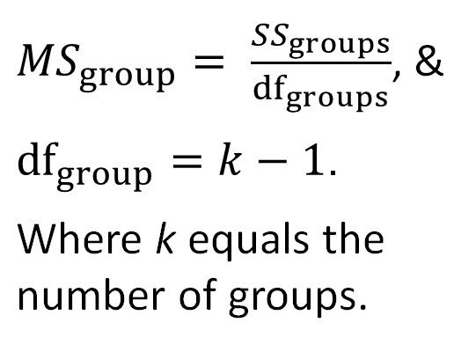
Calculating the mean squares
The Mean Squares Group is the deviation of group means from the grand mean.
Notes:
Sums of squares can be used to calculate the average

Slide 23
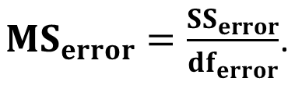
Calculating the mean squares
Mean square error measures the variation WITHIN sampled groups.
df_{error} = N-k
Notes:
Sums of squares can be used to calculate the average

Slide 24
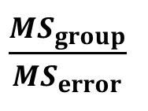
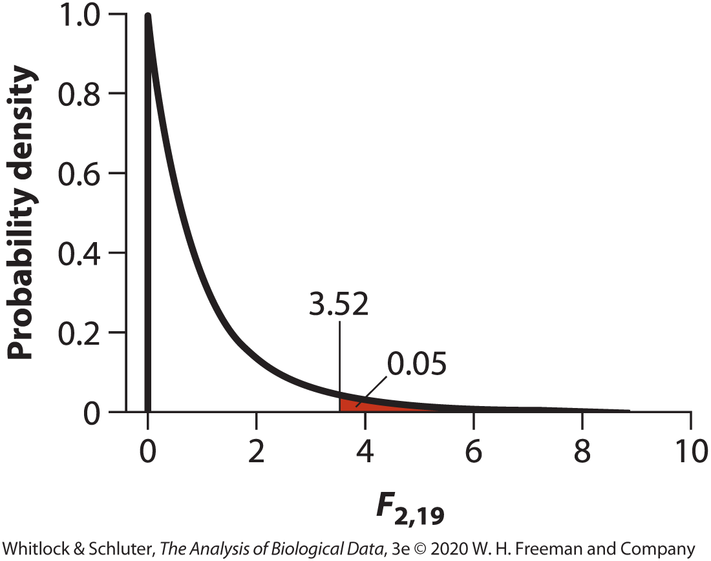
Variance ratio: F
Source of variation | Sum of squares | df | Mean squares | F-ratio | P
Groups (treatment) | 7.224 | 2 | 3.6122 | 7.29 | 0.004
Error | 9.415 | 19 | 0.4955
Total | 16.639 | 21
F =
Notes:
Null hypothesis is that variation of individuals among groups (MS_{groups} = variation of individuals within groups (MS_{error})
Under null hypothesis, F = 1

Slide 25
Variance ratio: F
Source of variation | Sum of squares | df | Mean squares | F-ratio | P
Groups (treatment) | 7.224 | 2 | 3.6122 | 7.29 | 0.004
Error | 9.415 | 19 | 0.4955
Total | 16.639 | 21
F =
Reject H₀. At least one population mean is different from the others.
Notes:
Null hypothesis is that variation of individuals among groups (MS_{groups} = variation of individuals within groups (MS_{error})
Under null hypothesis, F = 1

Slide 26


Variance Explained: R²
$R^{2}$ summarizes the proportion of total variance “explained” by group membership.

Slide 27

Variance Explained: R²
$R^{2}$ summarizes the proportion of total variance “explained” by group membership.
$$R2=\frac{7.224}{16.639}=0.43$$
In circadian rhythm example, 43% of total sum of squares among subjects is explained by differences among light treatments. Remaining 57% is variance unexplained by light treatment (error)

Slide 28
One-way ANOVA Assumptions
Measurements in every group represent a random sample from the corresponding population

Slide 29

One-way ANOVA Assumptions
Measurements in every group represent a random sample from the corresponding population
Variable is normally distributed in each of the $k$ populations

Slide 30

One-way ANOVA Assumptions
Measurements in every group represent a random sample from the corresponding population
Variable is normally distributed in each of the $k$ populations
Variance is the same in all $k$ populations

Slide 31

One-way ANOVA Assumptions
Measurements in every group represent a random sample from the corresponding population
Variable is normally distributed in each of the $k$ populations
Variance is the same in all $k$ populations
**ANOVA is relatively robust to departures from normality if n is large in each group and to unequal variances if n is large and similar among groups and if the difference in variances <10x

Slide 32
The analysis of variance
The F-ratio comparison used in an ANOVA is verbally described by which of the following?
Error mean square divided by group mean square.
Error mean square divided by overall mean square.
Group mean square divided by error mean square.
Group mean square divided by overall mean square.

Slide 33
The analysis of variance (answer)
The F-ratio comparison used in an ANOVA is verbally described by which of the following?
Error mean square divided by group mean square.
Error mean square divided by overall mean square.
Group mean square divided by error mean square.
Group mean square divided by overall mean square.
The correct answer is C.

Slide 34
A Posteriori Comparisons of Means
After significant ANOVA results

Slide 35
A Posteriori Comparisons of Means
After significant ANOVA results
Two types:
Planned: k-1 or less, determined before experiment starts (e.g., contrast with control only), must have strong justification
Unplanned: All possible pair-wise comparisons, less powerful because you are making more comparisons

Slide 36
A Posteriori Comparisons of Means
After significant ANOVA results
Two types:
Planned: k-1 or less, determined before experiment starts (e.g., contrast with control only), must have strong justification
Unplanned: All possible pair-wise comparisons, less powerful because you are making more comparisons
All posteriori tests have goal of controlling experiment-wide Type I error

Slide 37
A Posteriori Comparisons of Means
After significant ANOVA results
Two types:
Planned: k-1 or less, determined before experiment starts (e.g., contrast with control only), must have strong justification
Unplanned: All possible pair-wise comparisons, less powerful because you are making more comparisons
All posteriori tests have goal of controlling experiment-wide Type I error
No ‘best’ approach—all are different and may give different results

Slide 38
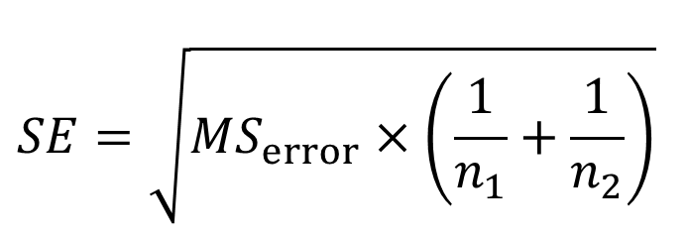

Planned Comparisons
E.g., how big is the difference between the knee-treatment and control groups? Is the difference between groups statistically significant?
Procedure similar to t-test, but uses different standard error
and
$$df={df}_{error}=N−k$$
Notes:
-

Slide 39
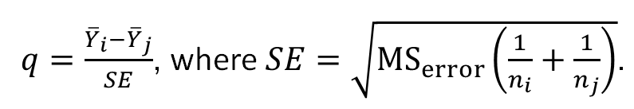
Unplanned Comparisons
Aka post-hoc tests
Need to adjust for inflated false positive rates (Type I errors)
E.g., Tukey-Kramer method, with test statistic q
Notes:
-like a series of t-tests, but uses larger critical value to limit Type I error rate

Slide 40
Unplanned Comparisons
E.g., Bonferroni Corrections
Divides experiment-wide alpha by the number of comparisons to give an adjusted α level (α’) for each individual test
α’ = α/k, k = number of comparisons
For a comparison to be significant, p-value must be lower than the adjusted p-value
Notes:
-

Slide 41
Kruskal-Wallis Test
Non-parametric alternative to one-way ANOVA
Similar to Mann-Whitney U test, based on ranks

Slide 42
Kruskal-Wallis Test
Non-parametric alternative to one-way ANOVA
Similar to Mann-Whitney U test, based on ranks
Example: 3 groups, want to test for a difference among groups
A | B | C
23 | 1 | 1
8 | 7 | 2
1 | 8 | 6
17 | 53 | 3
 | 67 | 4
 | 50

Slide 43
Kruskal-Wallis Test
Step 1: assign ranks
Note for ties: take average rank (e.g., 3 ones all get ranks of 2, the 2 eights get ranked 9.5)
A | B | C
23 (12) | 1 (2) | 1 (2)
8 (9.5) | 7 (8) | 2 (4)
1 (2) | 8 (9.5) | 6 (7)
17 (11) | 53 (14) | 3 (5)
 | 67 (15) | 4 (6)
 | 50 (13)

Slide 44
Kruskal-Wallis Test
Step 2: Calculate mean observed rank
A | B | C
23 (12) | 1 (2) | 1 (2)
8 (9.5) | 7 (8) | 2 (4)
1 (2) | 8 (9.5) | 6 (7)
17 (11) | 53 (14) | 3 (5)
 | 67 (15) | 4 (6)
 | 50 (13)
34.5 | 61.5 | 24
4 | 6 | 5
8.6 | 10.3 | 4.8
Sum of ranks
n
Mean rank

Slide 45




Kruskal-Wallis Test
Step 3: Calculate Kruskal-Wallis test statistic (H)
$$H=\frac{12}{N\left(N+1\right)}\sum_{1}^{i}{\frac{R_{i}^{2}}{n}−3\left(N+1\right)}$$
$N$: sample size
$n_{i}$: sample size in group $i$
$R_{i}$: rank sum in group $i$

Slide 46



Kruskal-Wallis Test
Step 3: Calculate Kruskal-Wallis test statistic (H)
$$H=\frac{12}{N\left(N+1\right)}\sum_{1}^{i}{{n_{i}R}_{i}^{2}−3\left(N+1\right)}$$
$N$: sample size
$n_{i}$: sample size in group $i$
$R_{i}$: mean rank sum in group $i$
$$H=[\frac{12}{15\left(15+1\right)}(4×{8.6}^{2}+6×{10.3}^{2}+5×{4.8}^{2})]−3\left(15+1\right)$$
= 4.14

Slide 47

Kruskal-Wallis Test
Step 4: Determine the p-value
H statistic approximates a chi-square (χ²) statistic with the number of groups minus one degrees of freedom (k-1)
$$χ_{2}^{2}$$

Slide 48

Kruskal-Wallis Test
Step 4: Determine the p-value
H statistic approximates a chi-square (χ²) statistic with the number of groups minus one degrees of freedom (k-1)
In this case,
$$χ_{0.05}^{2}=5.99$$
H = 4.14
$$χ_{2}^{2}$$

Slide 49

Kruskal-Wallis Test
Step 4: Determine the p-value
H statistic approximates a chi-square (χ²) statistic with the number of groups minus one degrees of freedom (k-1)
In this case,
$$χ_{0.05}^{2}=5.99$$
H = 4.14
Fail to reject the null hypothesis (could apply a correction factor for ties)
$$χ_{2}^{2}$$

Slide 50
Kruskal-Wallis Test Assumptions
Group samples are random samples
Distribution of variable must have same shape in every group if you are comparing medians
**Lower power than ANOVA when sample sizes small, similar power when sample sizes are large

Slide 51
Nonparametric multiple comparisons
Similar idea to Tukey’s post-hoc tests
Can be implemented in R
Examples include
Dunn Test for multiple comparisons: appropriate for groups with unequal numbers
Nemenyi Test: appropriate when groups have equal numbers
Pairwise Mann-Whitney U tests with adjusted p-values

Slide 52
Summary
One-way ANOVAs are appropriate when the predictor variable is categorical and the response variable is continuous

Slide 53
Summary
One-way ANOVAs are appropriate when the predictor variable is categorical and the response variable is continuous
ANOVA compares means of >2 groups by comparing the variance among subjects within groups with the variation among the sampled individuals in different groups

Slide 54
Summary
One-way ANOVAs are appropriate when the predictor variable is categorical and the response variable is continuous
ANOVA compares means of >2 groups by comparing the variance among subjects within groups with the variation among the sampled individuals in different groups
Posteriori tests are used to determine which means are different, and include planned and unplanned comparisons

Slide 55
Summary
One-way ANOVAs are appropriate when the predictor variable is categorical and the response variable is continuous
ANOVA compares means of >2 groups by comparing the variance among subjects within groups with the variation among the sampled individuals in different groups
Posteriori tests are used to determine which means are different, and include planned and unplanned comparisons
Kruskal-Wallis test is a non-parametric alternative to one-way ANOVA

